Slide 1

RUST LANGUAGE
Group Members
IT21169076
IT21184994
IT21164576
IT21177750

Slide 2
What is operating system?
An operating system (OS) is the program that, after being initially loaded into the computer by a boot program, manages all of the other application programs in a computer.
An Operating System (OS) is an interface between a computer user and computer hardware. An operating system is a software which performs all the basic tasks like file management, memory management, process management, handling input and output, and controlling peripheral devices such as disk drives and printers.

Slide 3
What is RUST Language
Rust is a young programming language gaining increased attention from software developers since it was introduced to the world by Mozilla in 2010.
Rust is a systems programming language meant to supersede languages like C++.
The main focus of Rust is (memory) safety, but it later began to target performance as well, adopting the C++ approach of zero cost abstraction
Rust has other advantages that make it much more versatile than them

Slide 4
Performance
Rust uses the idea of zero-cost abstraction to simplify the language without sacrificing efficiency, as was noted in the introduction.
Rust utilizes the concept of zero cost abstraction to simplify the language without limiting performance.
The absence of a trash collector, which provides various performance advantages, is the second noteworthy advantage of Rust.

Slide 5
Security
While there sometimes has been a perception that, because Rust ensures memory safety, the language is 100% secure
Although Rust provides memory safety guarantees, it can sometimes slip through the cracks via implementation errors.
Rust's memory safety operations can never be completely disabled

Slide 6
Safety
Through recent research on Rust, this new language was found to outperform well-established languages in terms of safety. Rust was found to be the safest language compared to C, C++, Java, Go, and Python.
Rust is a multi-paradigm, general-purpose programming language. Rust emphasizes performance, type safety, and concurrency.

Slide 7
Memory safety of Rust
No buffer overflows
Buffer overflows don't exist in the Rust programming language. In the C language, array capacity is not verified on access when compared.
No dangling pointers
Dangling references are usually a result of invalid coding.
In rust, the compiler grantees that references will never be dangling references.
No data races
A secure Rust guarantee prevents data races. Rust's ownership mechanism frequently prevents data races.

Slide 8
a freestanding rust binary
It is necessary to write code that is independent of any operating system features to create an operating system kernel. As a result, we are unable to use any functionality that depends on OS abstractions or particular hardware, including threads, files, heap memory, the network, random numbers, and standard output
In order to create an OS kernel in Rust, we need to create an executable that can be run without an underlying operating system

Slide 9
Allocator designs
What allocator does Rust use?
Struct std::alloc::System
The default memory allocator provided by the operating system. This is based on malloc on Unix platforms and HeapAlloc on Windows, plus related functions. It can also be used directly to allocate memory independently of whatever global allocator has been selected for a Rust program.
An implementation of Allocator can allocate, grow, shrink, and deallocate arbitrary blocks of data described via Layout .

Slide 10
a minimal rust kernal
Installing Rust nightly
The stable, beta, and nightly release channels for Rust are available. Spend a moment reading The Rust Book to learn more about how these channels differ from one another. Installing a nightly version of Rust is necessary since we will need some experimental capabilities for developing an operating system that is only accessible on the nightly channel.
I suggest using Rust up to handle Rust installations. It makes it simple to upgrade them and lets you install the nightly beta and stable compilers side by side. Run Rust up override set nightly to use a nightly compiler for the current directory with rust up. Alternatively, you can place a file named rusttoolchain in the project's root directory with the content nightly

Slide 11
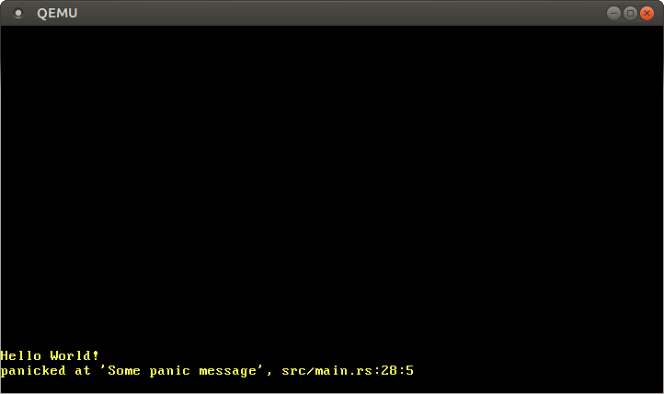
Vga text mode
The VGA text mode is a simple way to print text to the screen.
To print a character to the screen in VGA text mode, it must be written to the text buffer of the VGA hardware.
The VGA text buffer is accessible via memory-mapped I/O to the address 0xb8000. That reads and writes to that address but doesn’t access the RAM but directly accesses the text buffer, so we can read and write through normal memory operations to that address.

Slide 12
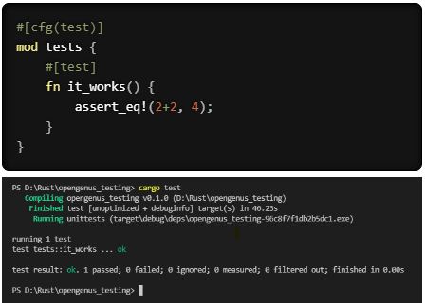
testing
Tests are Rust functions that verify that the non-tested code is functioning in the expected manner. The bodies of test functions typically perform some setup, run the code we want to test, and assert whether the result is exactly what we expected.
The simplest way to do tests in Rust is by using the test configuration and test macro. A simple test is mentioned below.

Slide 13
cpu exceotions
CPU exceptions occur in various situations like when accessing an invalid memory address or when dividing by 0. To react to those exceptions, we must set up an interrupt descriptor table that provides handler functions. In the end, the kernel of our CPU will be able to catch breakpoint exceptions and resume normal execution after
There are 20 different CPU exception types. The most important ones are:
Page fault: occurs on illegal memory accesses.
Invalid opcode: occurs when the current instruction is invalid.
General protection fault: occurs on various kinds of access violations..

Slide 14
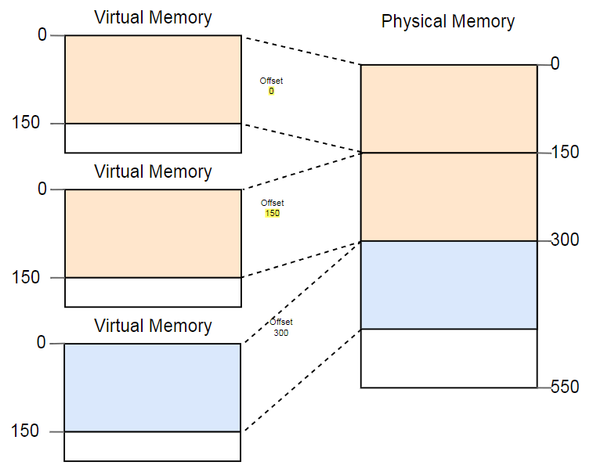
introduction to paging
introduces paging, a widely used method of managing memory that we will also implement in our operating system.
It defines virtual memory, shows how segmentation works, explains why memory isolation is necessary and describes how paging addresses memory fragmentation issues.
Additionally, it investigates the x86 64 architecture's multilevel page table arrangement.
What is paging?
What is a page table?

Slide 15
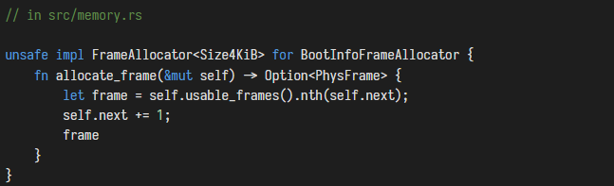
Paging implementation
page implementation is how to make our kernel support paging. It initially examines various methods for making the physical page table frames available to the kernel and considers each one's benefits and shortcomings.
After that, a function for translating addresses and one for creating new mappings are implemented
The implementation of the unsafe trait is the only way it works. When a method in a trait contains an invariant that the compiler is unable to check, the trait is considered unsafe.

Slide 16
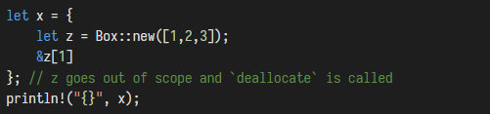
heap allocation
programming languages often support a third memory region for storing variables called the heap. The heap supports dynamic memory allocation at runtime through two functions called to allocate and deallocate
It works in the following way The allocate function returns a free chunk of memory of the specified size that can be used to store a variable.
currently use two types of variables in our kernel: local variables and static variables. Local variables are stored on the call stack and are only valid until the surrounding function returns. Static variables are stored at a fixed memory location and always live for the complete lifetime of the program.

Slide 17
async / await
Is Rust async hard?
In short, async Rust is more difficult to use and can result in a higher maintenance burden than synchronous Rust, but gives you best-in-class performance in return
Does Rust have async await?
async / . await is Rust's built-in tool for writing asynchronous functions that look like synchronous code. async transforms a block of code into a state machine that implements a trait called Future .
What is async and await in Rust?
On top of Futures, we have async / await which is a language feature that allows us work with Future-based code (async code) as if that code was executed synchronously.

Slide 18
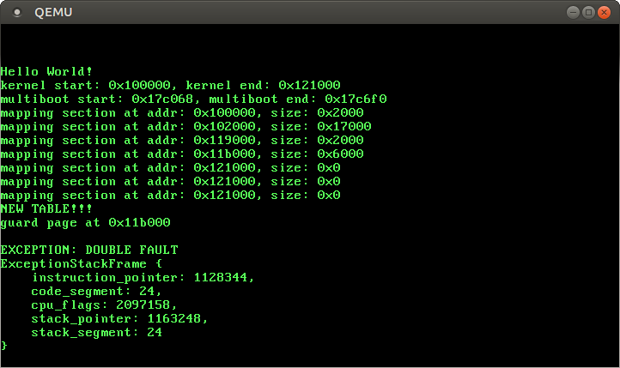
Double faults
For example, it occurs when a page fault is triggered but there is no page fault handler registered in the Interrupt Descriptor Table (IDT)
a double fault is a special exception that occurs when the CPU fails to invoke an exception handler
What happens when you double fault?
In tennis, if a player serves a double fault, they make a mistake with both serves and lose the point.

Slide 19
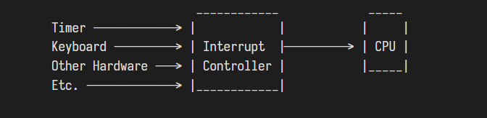
Hardware interrupts
What is meant by hardware interrupt?
A hardware interrupt is an electronic signal from an external hardware device that indicates it needs attention from the OS.
The CPU can be informed by associated hardware devices using interrupts.
example of this is moving a mouse or pressing a keyboard key. In these examples of interrupts, the processor must stop to read the mouse position or keystroke at that instant.

Slide 20
Rust provides the following features:
Zero cost abstraction.
Error messages.
Move semantics.
Threads without data races.
Pattern matching.
Guaranteed memory safety.
Efficient C bindings.
Safe memory space allocation.
Other Features Of Rust

Slide 21
Resources
Rust Programming Language. (n.d.). Retrieved October 20, 2022, from https://www.rust-lang.org/
The Rust Programming Language - The Rust Programming Language. (n.d.). Retrieved October 20, 2022, from https://doc.rust-lang.org/book/
A - Keywords - The Rust Programming Language. (n.d.). Retrieved October 20, 2022, from https://doc.rust-lang.org/book/appendix-01-keywords.html
Oppermann, P. (2018, February 10). A Minimal Rust Kernel | Writing an OS in Rust. Retrieved October 20, 2022, from https://os.phil-opp.com/minimal-rust-kernel/

Slide 22
THANK YOU!

